Slide 1

Prescription Label Reading
MINOR PROJECT
Project No. - 63
Swapnil Pant 201B278
Satyam Thakur 201B244
Utkarsh Mathur 201B294
Project Guide :
Dr. Nileshkumar R. Patel

Slide 2
Prescription Label Reading
MINOR PROJECT
Project No. - 63
Swapnil Pant 201B278
Satyam Thakur 201B244
Utkarsh Mathur 201B294
Project Guide :
Dr. Nileshkumar R. Patel

Slide 3
Table of Contents
Serial No. | Title | Slide No.
1 | Recap - Problem Statement | 3-4
2 | Workflow | 5
3 | What is OCR? | 6
4 | Tech Stack | 7
5 | Results | 8-12
6 | References | 13

Slide 4

RECAP
Problem Statement
01c
Doctors in India are too busy to write digital prescriptions.
Prescription on paper can be tough to read and understand for the common folks.
After various attempts by our government, still this problem persists
Prescription reading will help solve the problem caused due to misinterpretation of prescriptions.

Slide 5
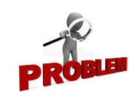
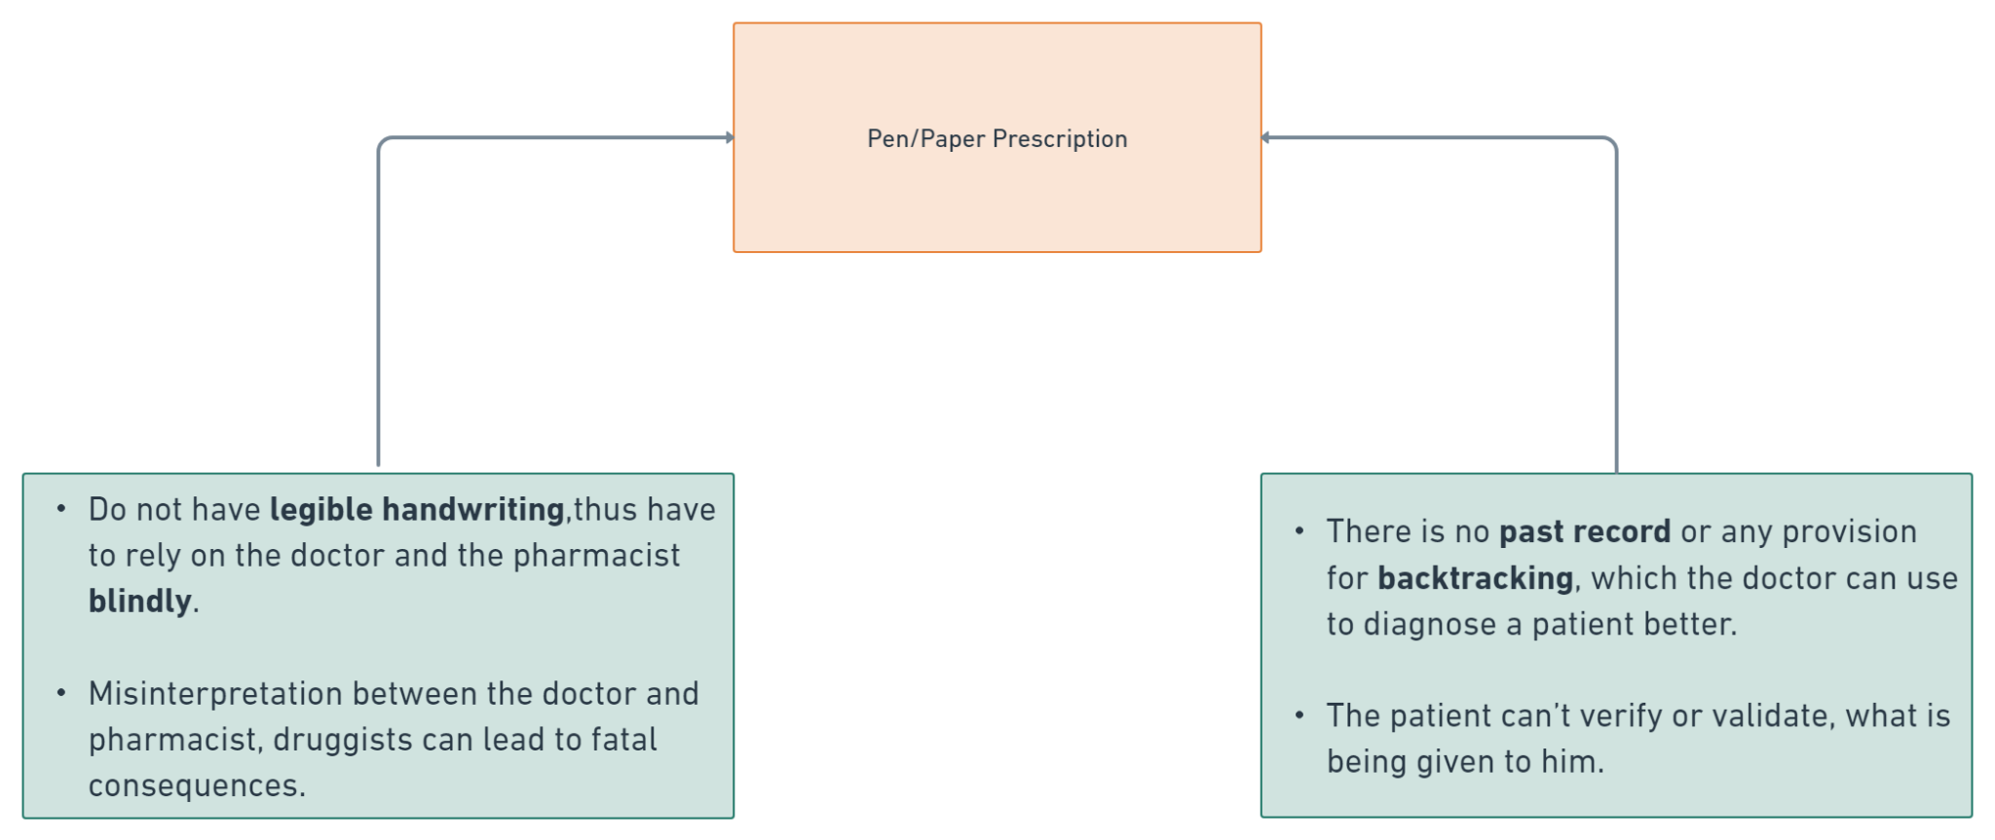
Problem Statement (contd.)

Slide 6
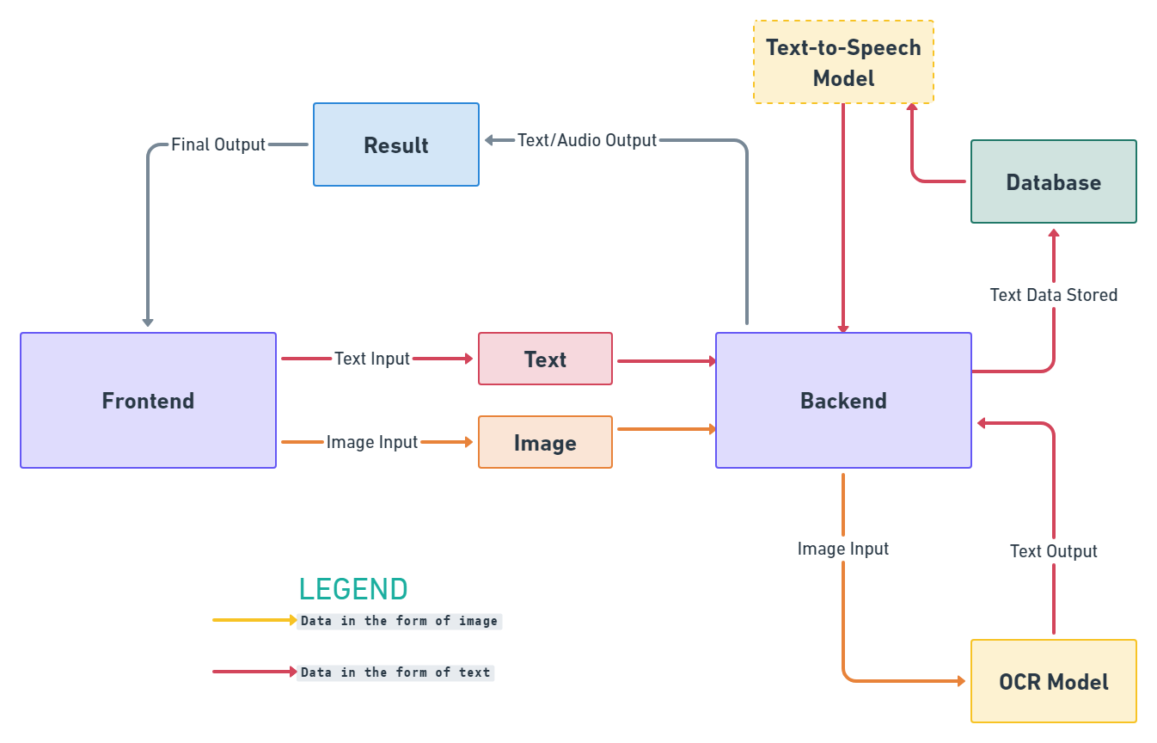
02 - WORKFLOW

Slide 7
What is OCR?
And how does it work?
03
OCR stands for Optical Character Recognition/
It is the process that converts an image of text into a machine-readable text format.
The OCR engine works by using the following steps:
Image acquisition
Preprocessing
Text recognition
Pattern matching
Feature extraction
Post processing

Slide 8



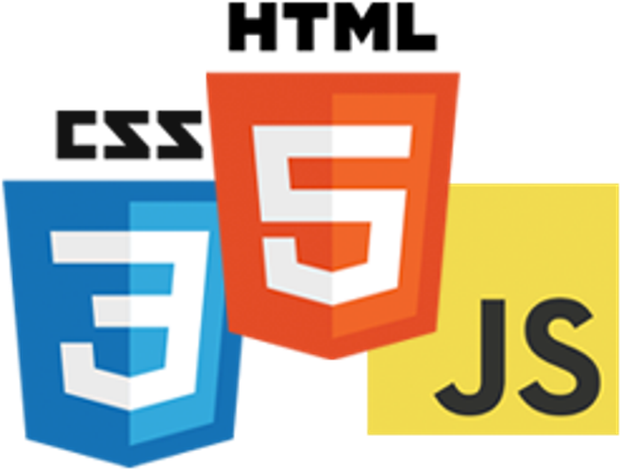



04 - Tech Stack
Keras
Tensorflow
React.js
HTML, CSS, JS
Python
PyTesseract
Flask

Slide 9
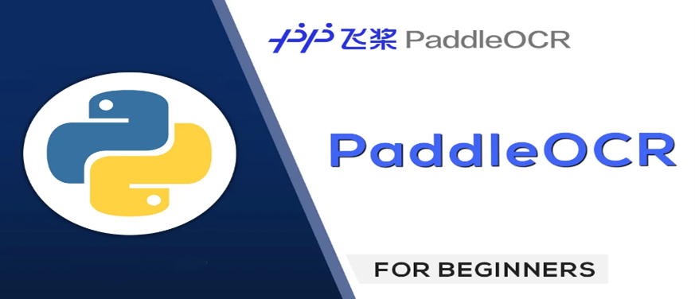
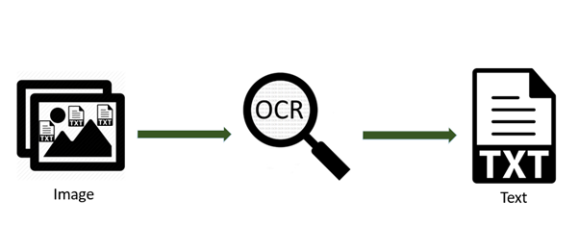
Results
Our Work So Far..
05

Slide 10
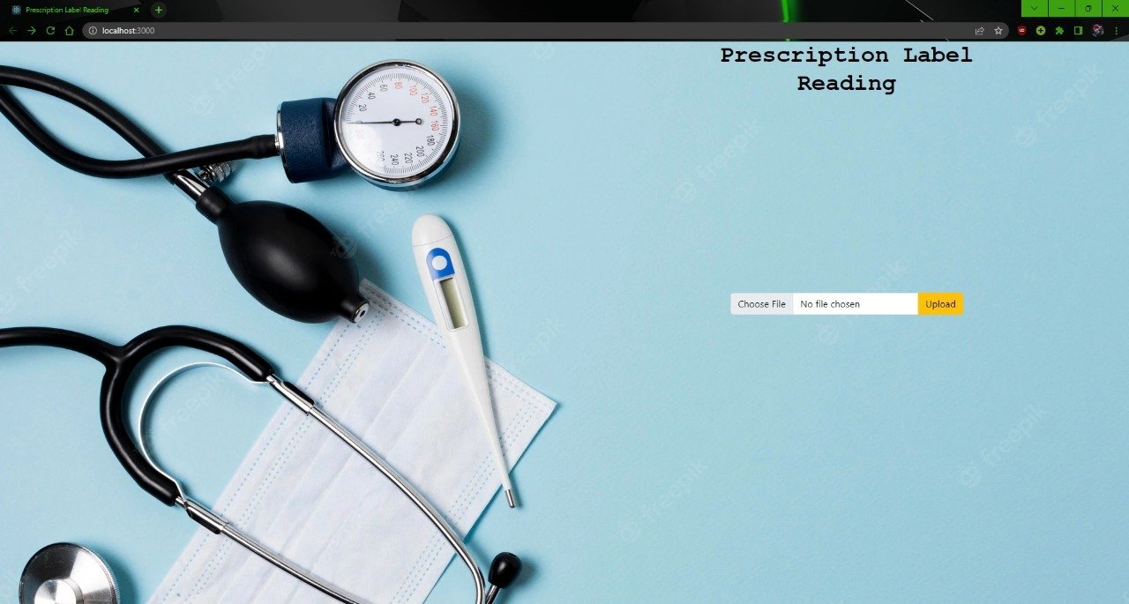
User Interface

Slide 11
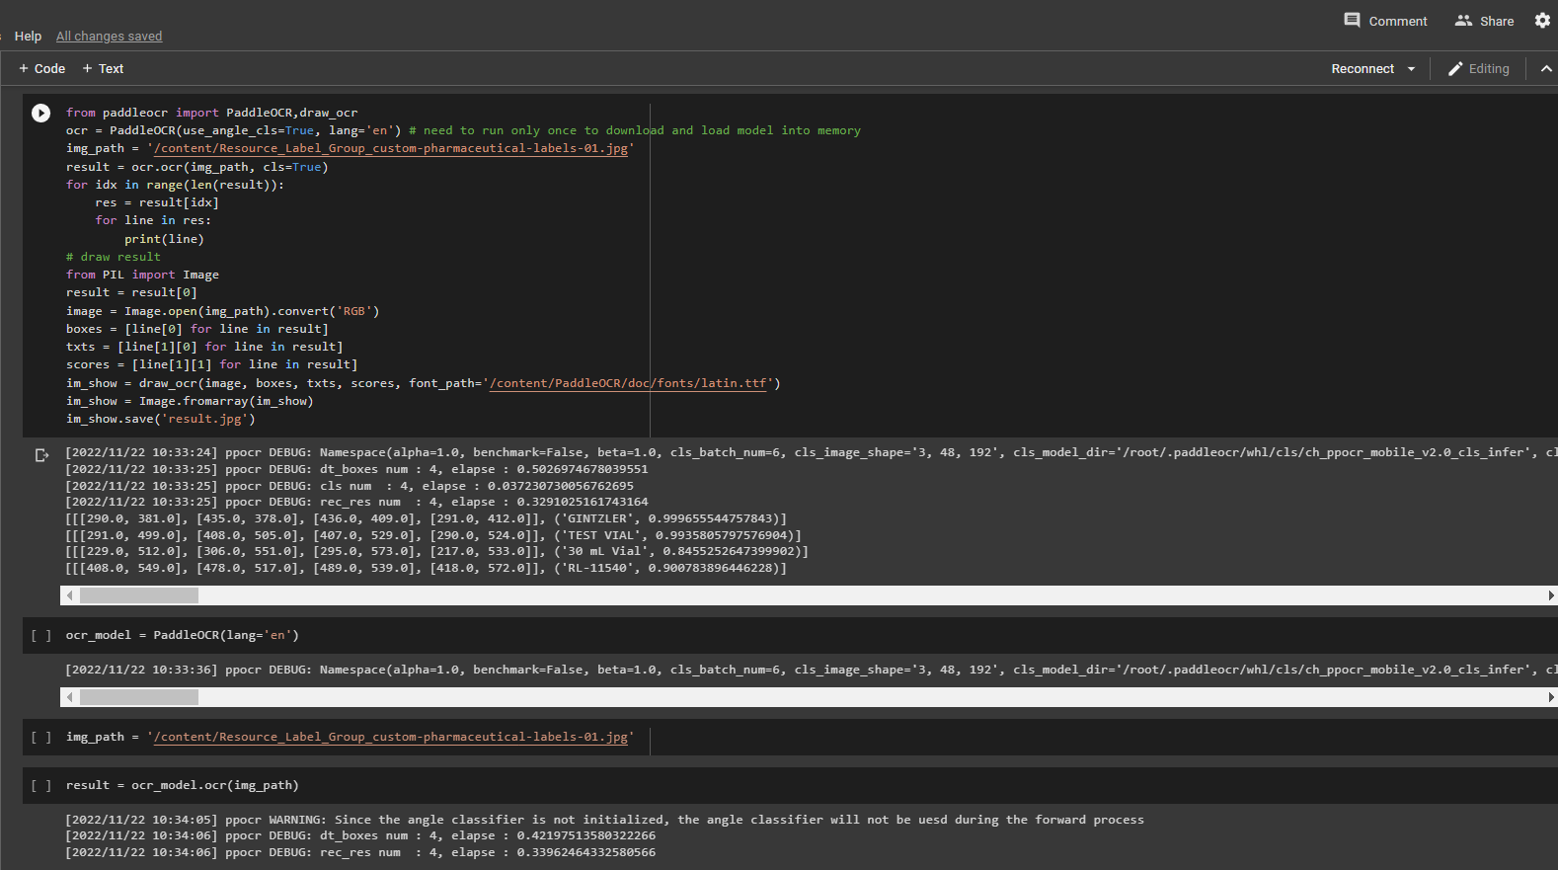
AI Models

Slide 12
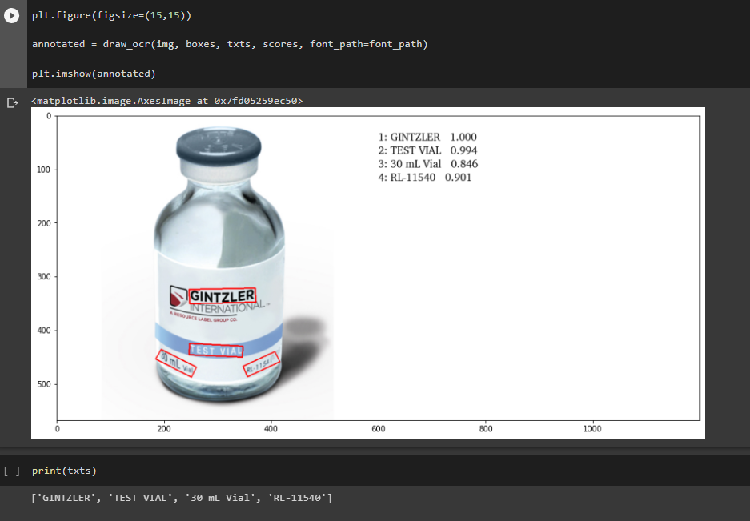

Slide 13
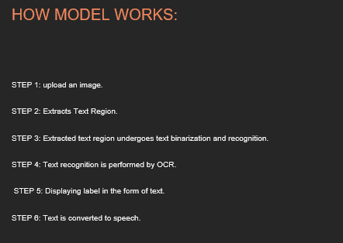

Slide 14
06 - References :
Automating data extraction from prescription document images to reduce human error (MIT Research Paper)
Link: https://dspace.mit.edu/handle/1721.1/128575
Health Literacy Level and Comprehension of Prescription and Nonprescription Drug Information
Link: https://www.mdpi.com/1660-4601/19/11/6665
Klippa - Medical prescription OCR & data capturing
Link: https://www.klippa.com/en/ocr/medical-documents/medical-prescription/

